Slide 1
The Market Whisperers:
How We Tame Our AI Models
Anton Antonov
Head of AI and Quant Research
antonov@dxfeed.com DKF Munich, 13.05.2025

Slide 2
Introduction
37% of conversations in “Computer & Mathematical” (Antropic)
71%
adoption rate of GenAI in business functions (Stanford AI report 2025)
2.6x/year
growth of training cost since 2016, frontier models, in $ (Epoch AI)
2023
year of PoCs
2024
year of production
2025
year of business value
In this talk:
Why making AI truly valuable in financial markets is difficult
How we manage it, with practical case studies

Slide 3

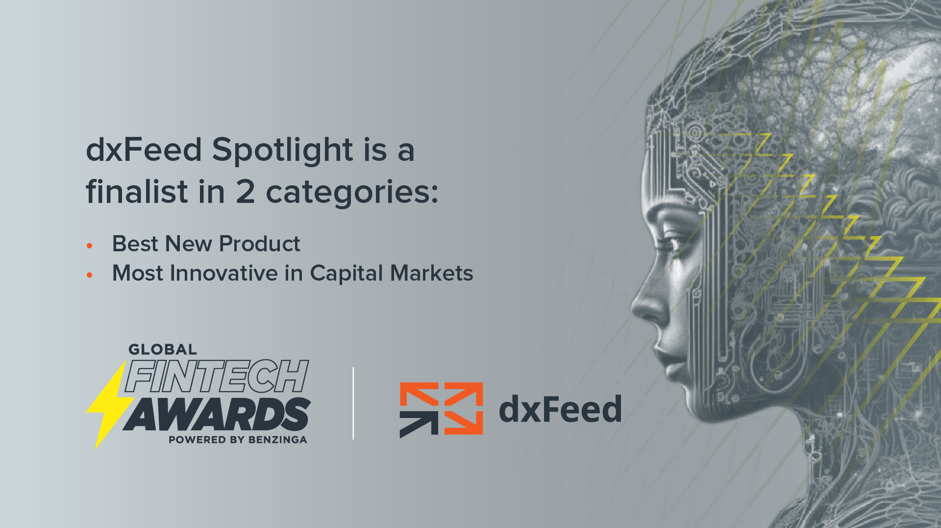
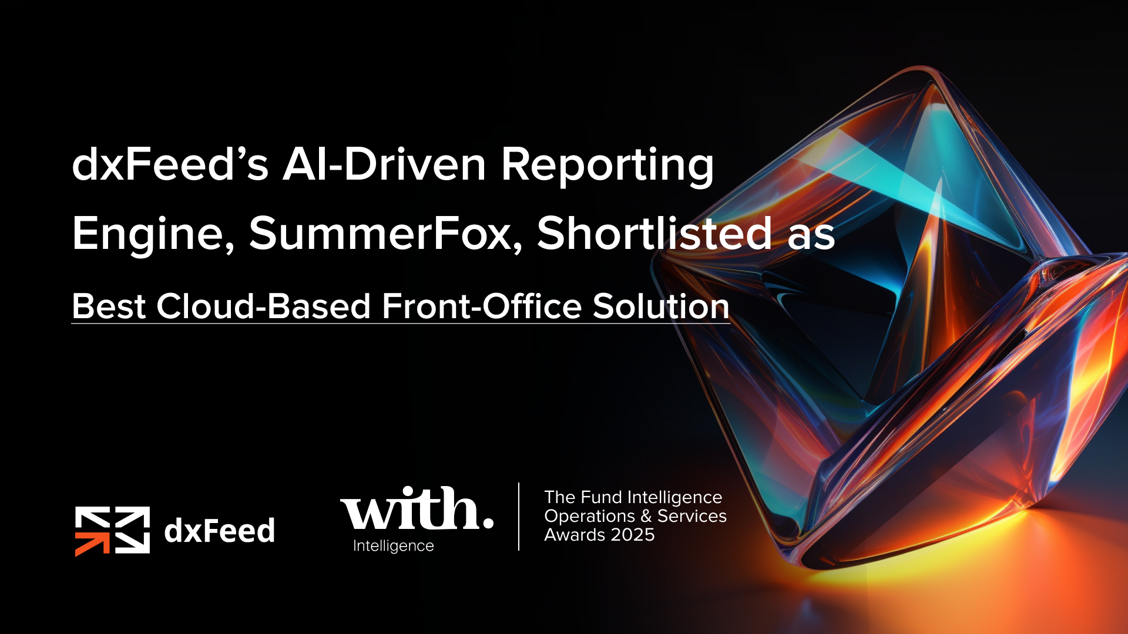


Slide 4
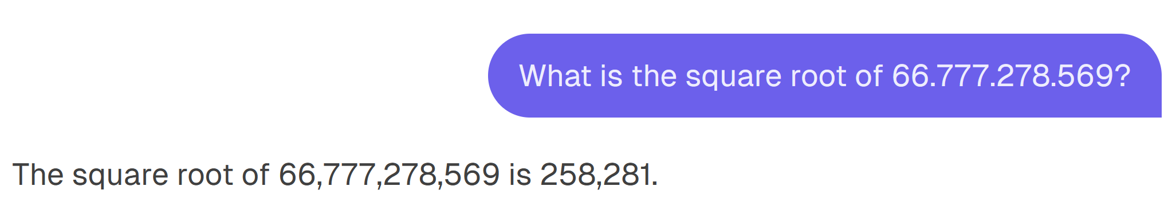
The AI Market Analysis Challenge
Unique demands of financial markets:
Real-time processing requirements
Low tolerance for errors
Multiple, often conflicting data sources
Complex interdependencies between data points
Common AI implementation pitfalls:
Over-reliance on black-box models
Insufficient data validation
Poor integration with existing systems
Neglecting calculation accuracy
258,413

Slide 5
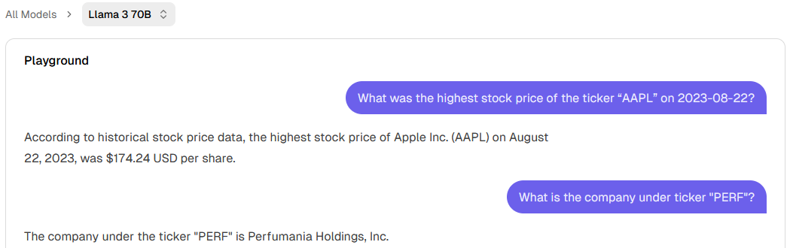
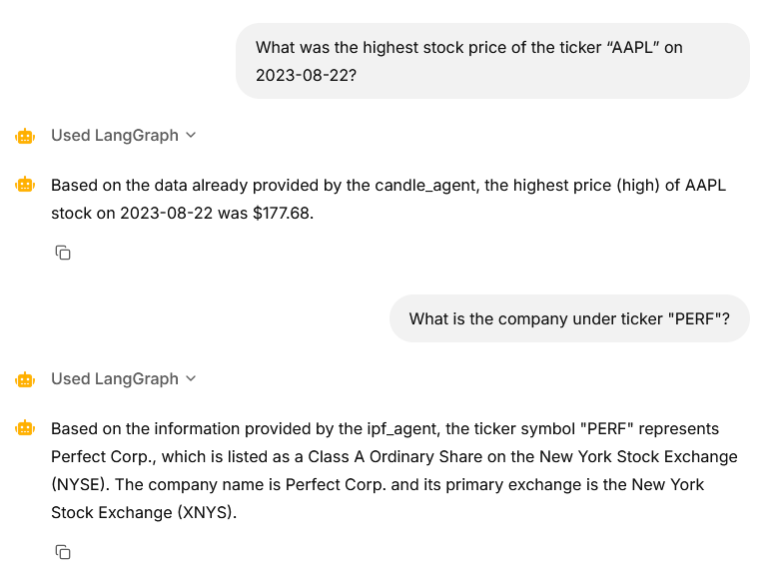

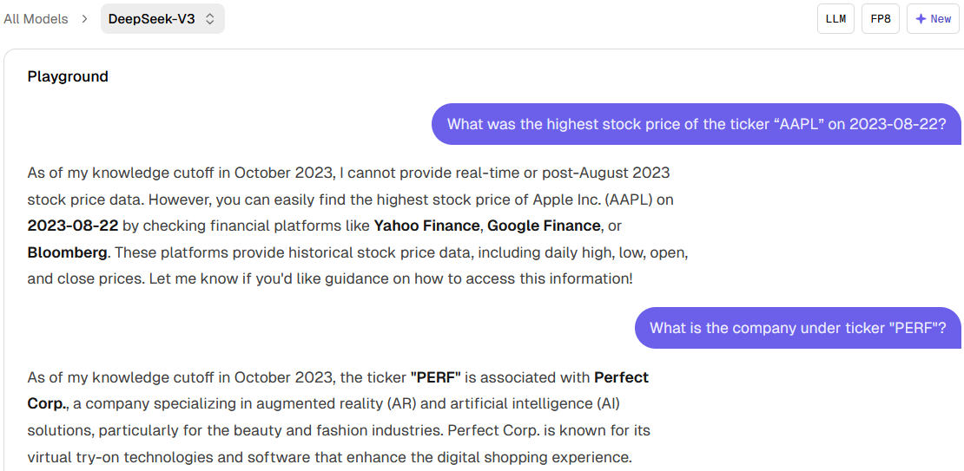
The AI Market Analysis Challenge
❌
❌
✅
❌
✅
✅
See also: Haoqiang Kang and Xiao-Yang Liu, Deficiency of Large Language Models in Finance: An Empirical Examination of Hallucination, https://arxiv.org/abs/2311.15548
LLM inference provided by Hyperbolic

Slide 6
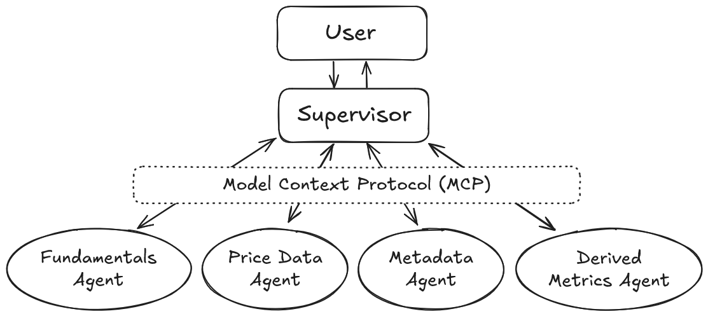
Our Approach, pt. 1: MCP
Model Context Protocol (MCP):
An open standard developed by Anthropic to enable AI models, particularly LLMs, to securely and efficiently access and interact with external data sources and tools.
Benefits:
real-time data access,
reduced integration complexity,
enhanced security and compliance.
“...like a USB-C port for AI applications”.
https://modelcontextprotocol.io

Slide 7
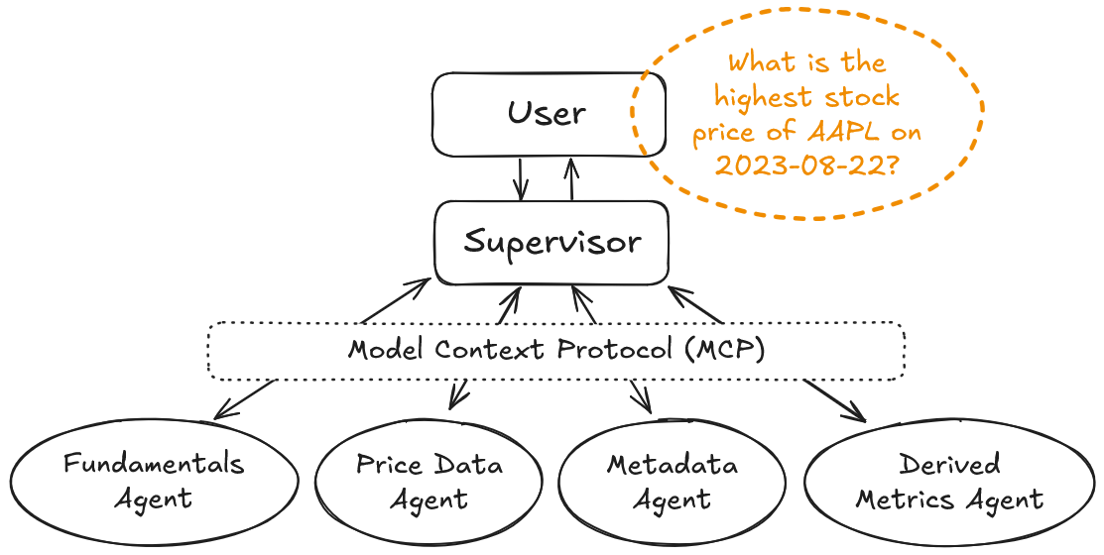
Our Approach, pt. 2: Tool Use

Slide 8
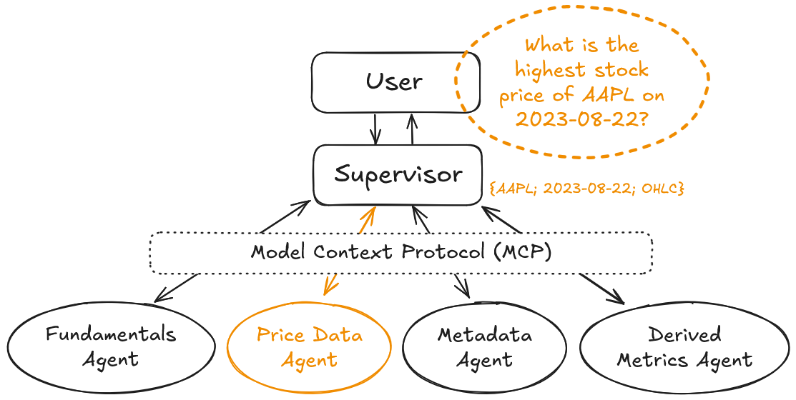
Our Approach, pt. 2: Tool Use

Slide 9
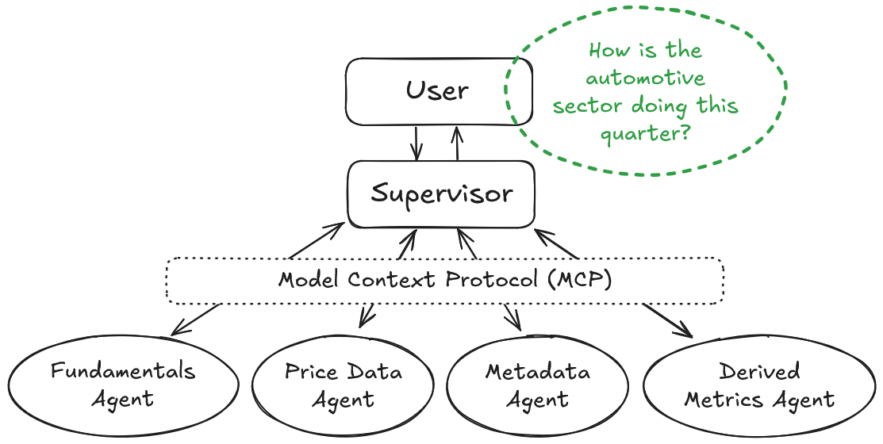
Our Approach, pt. 2: Tool Use

Slide 10
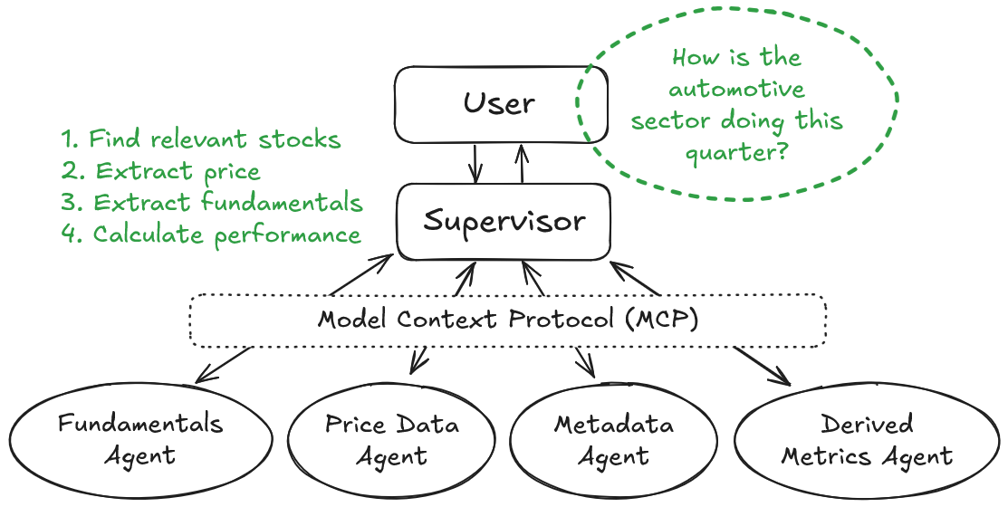
Our Approach, pt. 2: Tool Use

Slide 11
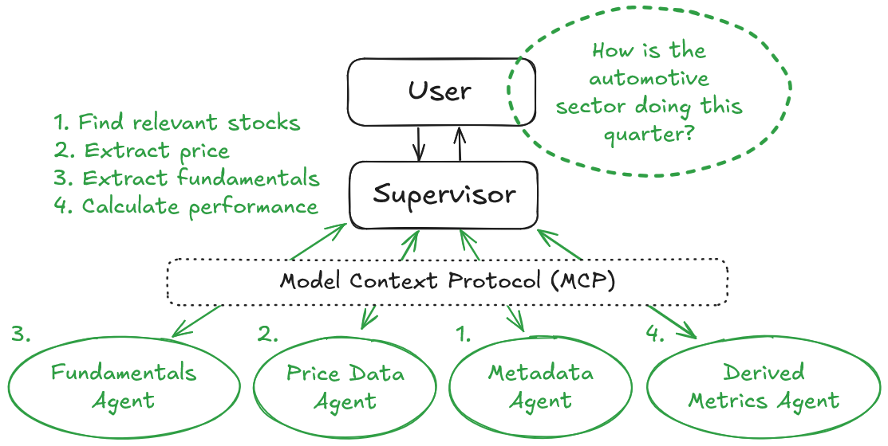
Our Approach, pt. 2: Tool Use

Slide 12
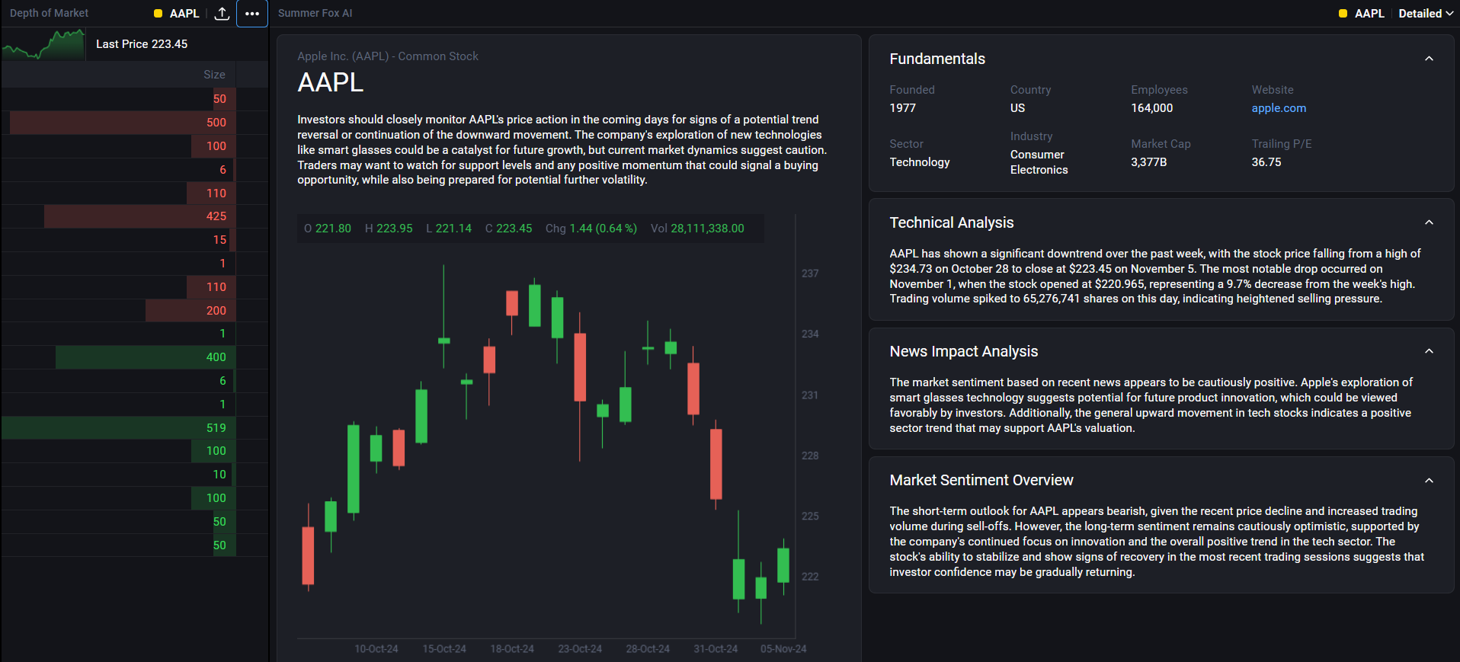
dxFeed SummerFox in Action
What is the the high-level outlook?
What data-driven insights are there?
How do recent news affect the stock?
What is the current market consensus?

Slide 13
Our Approach, pt. 3: Implementation
Prompt engineering techniques:
Be specific
Provide few-shot response examples
Establish specific guardrails
Make sure that the LLM does not do what it’s not good at (zero-shot reasoning, derived calculations)
Performance and audit:
Enable prompt and response caching
Implement tracing (e.g., via Langsmith)
Have multiple independent LLM vendors
Quality control through Deepeval
Key metrics to monitor:
Factual correctness
Alignment
Toxicity
Contextual relevancy
Bias
Hallucination rates
Adherence to guardrails
Eval cycles in the development workflow:
At new releases
For switchover to new models
As early warnings of model degradation

Slide 14
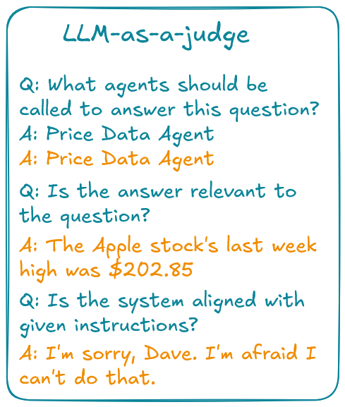
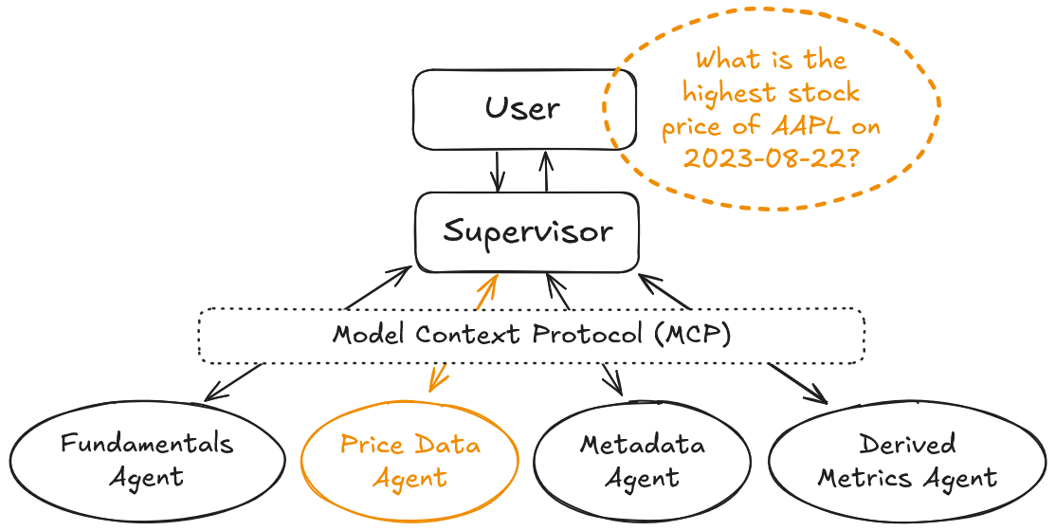
Our Approach, pt. 3: Evals
✅
❌
✅
What is the point validating LLM against itself?
Against a bigger and better model!
❌

Slide 15
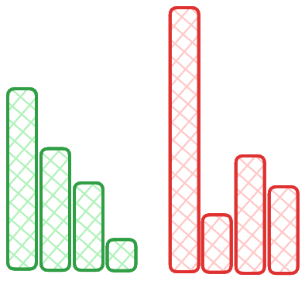
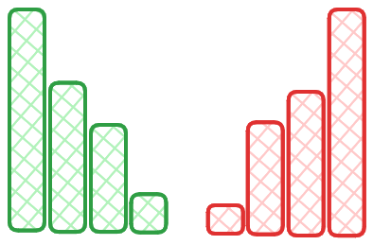
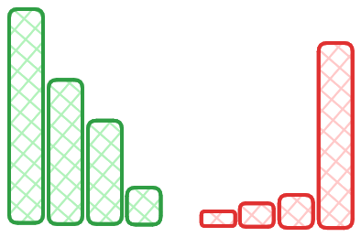
Our Approach, pt. 4: In-house Models
The Market Anomaly Detection Challenge:
The needle in the haystack problem: rare and fuzzily defined events
Rule-based or feature engineered conditions:
Must be manually constructed or selected
Must be calibrated and recalibrated
May get outdated quickly
Anomaly?
Anomaly?

Slide 16
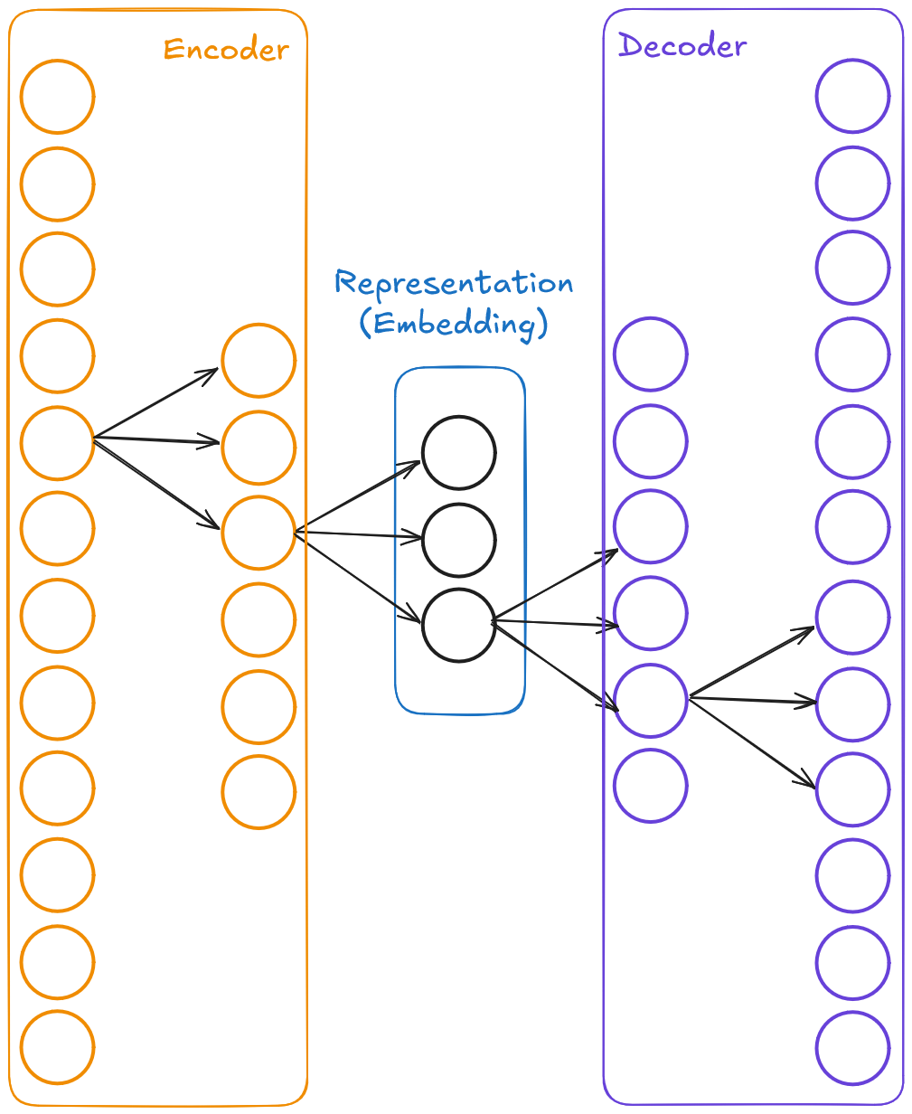
Our Approach, pt. 4: In-house Models
Our training setup:
Order book snapshots sourced from Historical Data Lake (HDL)
Autoencoder architecture (unsupervised learning)
Reconstruction quality is what defines anomalousness
Full control over the neural net parameters and model weights

Slide 17
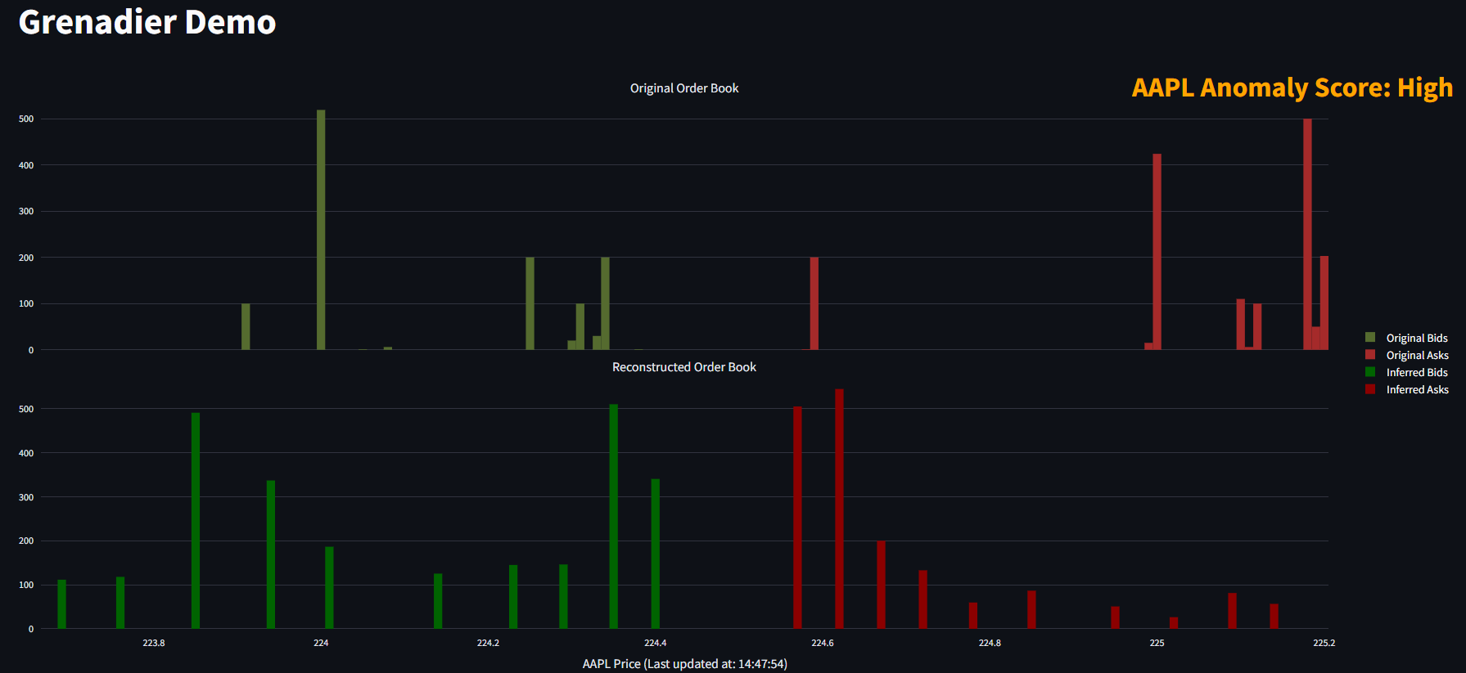
dxFeed Grenadier in Action
Large orders far from the spread
Pro tier: reconstructed book

Slide 18
Key Takeaways
AI in finance requires specialized approaches beyond generic LLMs
Agentic workflows with guaranteed knowledge extraction
In-house ML models trained specifically for financial applications
Model Context Protocol enables flexible, secure tool use
Output quality is secured via:
Data layers and calculation engines
“LLM-as-a-judge” tests and specialized evals
Full control over the training cycle for in-house models

Slide 19
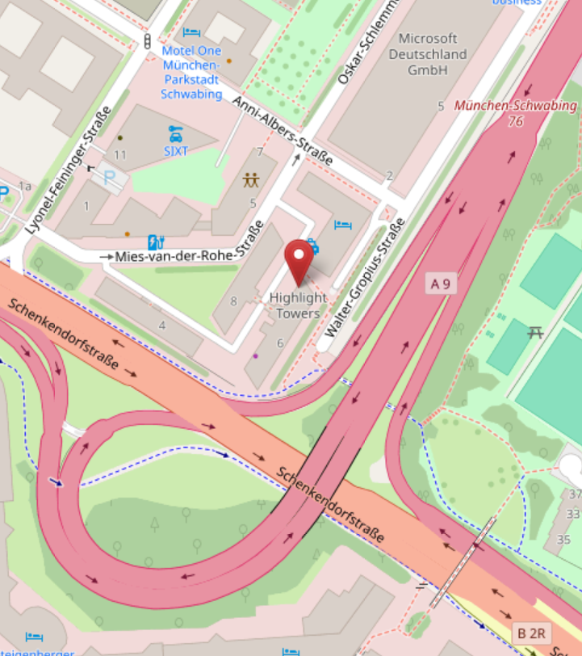
References
SummerFox: AI-driven market reporting engine
Grenadier: L2-based anomaly detection model
Follow dxFeed on LinkedIn or YouTube
Connect on LinkedIn: @tonytonov
Visit us in Highlight Towers!
Materials used:
The Anthropic Economic Index, https://www.anthropic.com/news/the-anthropic-economic-index
The 2025 AI Index Report by The Stanford Institute for Human-Centered AI, https://hai.stanford.edu/ai-index/2025-ai-index-report
Machine Learning Trends by Epoch AI, https://epoch.ai/trends
H. Kang and X.Y. Liu, Deficiency of Large Language Models in Finance: An Empirical Examination of Hallucination, https://arxiv.org/abs/2311.15548
J.P. Bouchaud, J. Bonart, J. Donier, M. Gould, Trades, Quotes and Prices: Financial Markets Under the Microscope, Cambridge University Press, 2018
Thanks!
www.dxfeed.com

